Slide 1
ENGINEERING MANAGEMENT
CSE 417 Section 15/AB Term II
Session 2017-18
Department of Computer Science and Engineering
Instructor: Arif S. Bhuiyan, MSEd

Slide 2
Chapter 10
Total Quality Management (TQM)

Slide 3
Introduction
Quality
Quality is defined by the consumers, rather than the designer or the inspector. A number of parameters associated with quality has been redefined as the concept of quality is gradually changing.
Total Quality Management (TQM)
It is essential to understand the term of “Total” and “Quality” in TQM.

Slide 4
Meaning of “Total” in TQM
Total in TQM means development of all aspects of an organization in satisfying the customer. This can be accomplished if a partnership environment at each stage of the business process is recognized within and outside the organization. It involves:
Customer-Supplier relationship based on mutual trust and respect and,
Win-win strategy for both
Organizations in-house requirements by the customers
Customer’s needs are well understood by the supplier
Suppliers are partners in achieving zero-defect situation
Regular monitoring of supplier’s processes and products by the customer.

Slide 5
Quality
Quality is defined by customer needs and expectations. Quality is what customer wants.
“ Quality is the totality of futures and characteristics of a product/service that bear on its ability to satisfy a given need” – American Society of Quality Control
“Quality refers to an level of functionality possessed by a product/service based on the producers capability and customer’s need” – Badiru and Ayeni (1993)

Slide 6
Dimensions of Quality
Performance
Features
Durability
Reliability
Serviceability
Appearance
Safety
Time
Compatibility

Slide 7
Juran’s Quality Trilogy
Juran’s Quality Trilogy
Quality Planning
Quality Control
Quality Improvement
Provided the basic foundation of TQM’s practical application.
He suggested the following 3 phases of activities for continuous quality improvement:

Slide 8
Juran’s Trilogy – Quality Planning
“Quality is required to be planned for which special training is required” – Juran
Four (04) steps for planning of quality
- Identify the customers and their needs (both external and internal customers)
- Translate the customer’s needs into technical specifications.
- Optimize the product design and process parameters capable of producing the required product
- Place the process into operation.

Slide 9
Juran’s Trilogy – Quality Control
Quality Control is the process of detecting adverse changes in the process and taking corrective action when the process shows signs of drifting from its optimal setting.
Statistical techniques and SPC should be used to control the quality. The activities include:
- evaluate the actual performance of the product
- compare the actual performance with the product goals
- act on the performance

Slide 10
Juran’s Trilogy – Quality Improvement
Quality problems may be classified into two broad categories: (1) Sporadic and (2) Chronic.
Sporadic Problems
- problems are sudden change for the worse
- are best handled by statistical techniques.
Chronic Problems
- problem persists for a long time
- problems are solved by behavioral models which involve teamwork and employee participation
- It is estimated that 80% losses are due to chronic problems
- A quality breakthrough is needed to reduce the cronic waste

Slide 11
Total Quality Management
TQM integration:
- management techniques, improvement efforts and technical tools under a single discipline
Objectives:
- Giving quality products to the customer
The Main Features of TQM are:
- Top management’s direct involvement
- Strong customer satisfaction
- Company-wide participation
- Systematic and documented methods for solving quality problems

Slide 12
Total Quality Management
TQM is a continuous and endless process of wanting to improve.
It aims to bring change in culture in a company, where each employee can directly participate in areas and decisions concerning his/her work.
It builds positive attitudes of employees towards quality and organization.
It enhances respect for each other leading a meaningful workplace

Slide 13
ISO (International Organization for Standardization)
Published the first FIVE standards on international Quality Assurance (QA), known as ISO 9000 Standards.
- These standards were described as “the refinement of all the most practical and generally applicable principles of quality systems” and “the culmination of agreement between the world’s most advanced authorities of these standards as the basis of a new era of quality management.

Slide 14
ISO (International Organization for Standardization)
The Actual Standards are:
ISO 9000 – a road map for use of other standards in this series. It defines five key quality items in the ISO terminology.
ISO 9001 – It specifies a model when two parties require the demonstration of a supplier’s capability to design, produce, install and service a product.
ISO 9002 – It specifies a model for quality assurance in production and installation.
ISO 9003 – It is a model for quality assurance in the final inspection.
ISO 9004 – It provides quality management guidelines for developing and implementing a quality system and in determining the extent to which every element is applicable.

Slide 15
ISO 9000 vs. TQM
ISO 9000
TQM
A set of standards and focuses on documents.
Product conforms to specification
Certification
Audits and checks
Key processes
Quality system
External trust
Visibility of capability prior to delivery
An assurance to external customers that a quality system is being pursued
TQM focuses on developing human elements.
Customer delight and satisfaction
Total organization – all resources
Internal and external trust
Leadership
Internal customer
Flexibility and change management
Top management commitment
Continuous improvement

Slide 16
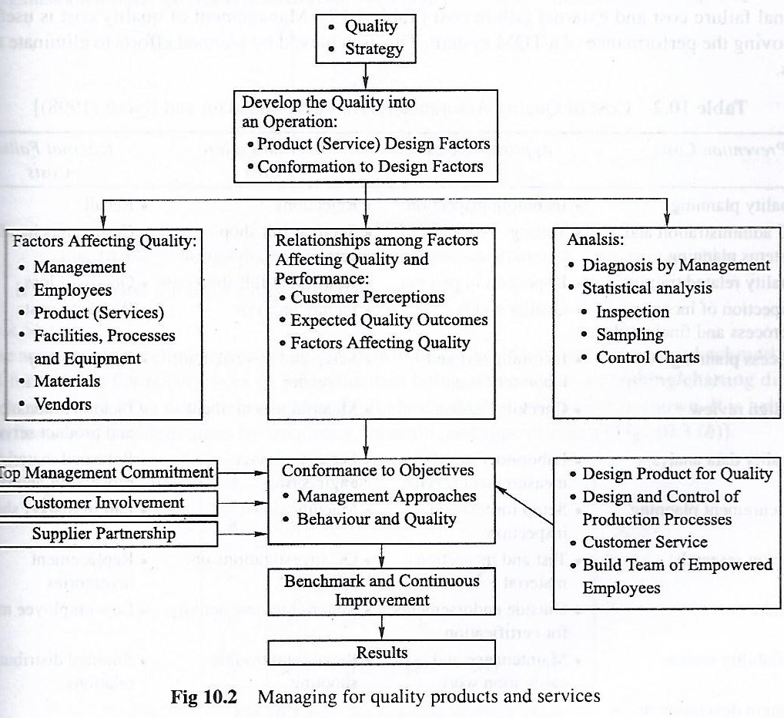
Integrated Model

Slide 17
Quality Circle
It provides an effective channel of communication between the employees and the top management for discussion on problems related to quality.
“A group who meet voluntarily and regularly to identify and solve their own work-related problems and implement their solutions with management approval”. (Industrial Society)
Consists of 6-12 members
Membership can be rotated or sub-group can be formed, if too many volunteers.
Senior or experienced members of the circle becomes leader
Unions are supportive and involved due to close workforce involvement and job satisfaction
“Structured way of making management listen”

Slide 18
Quality Circle
Identification of problem
Prioritization
Discussion and Investigation
Solution
Action, if authorized
Presentation to managers

Slide 19
Quality Control
Quality Control can be defined as being concerned with checking for errors during and after the process of manufacture.
Modern control techniques are based on idea of (1) error-free or (2)zero-defect approach or (3) doing it right first time.
Reason – costs involved in correcting errors
At the strategic management level, decisions are made about total quality management and systems of quality control.
The strategic approach includes:
- Analysis of current position
- Choice of an appropriate starting point
- Implementation of policy, deciding what will be done, how, by whom and by when.

Slide 20
Quality Assurance (QA)
Quality Assurance provides a framework for quality control and quality improvement.
QA supports teams of employees with
- systems, resources, and discretion appropriate to their unique contribution to the organization,
- to keep them in tune with progress of quality management and improvement.
How Management can help teams?
- Understand quality characteristics
- Be realistic about the standards to be attained
- Undertake quality control through a measurement process, interpret the results and make propose changes

